Slide 1
Installing Selenium for NetBeans

Slide 2
Selenium WebDriver
More complicated tool
Allows you to write repeatable scripts in a programming language
Does not record your actions
Can simulate mouse motion
Can run tests in multiple browsers
Tests execute very quickly

Slide 3
The WebDriver
The WebDriver is what allows selenium to access the internet and connect to different webpages
There is a Driver for each Web Browser: Firefox, IE, Microsoft Edge, and Google Chrome.
To access the Driver you need to set the system property for the corresponding Browser
You also need to set the WebDriver variable to the corresponding Browser

Slide 4
Create a Selenium folder
Create a folder on your storage named selenium
Copy all of the upcoming files you download to this folder
KNOW THE EXACT PATH TO THIS FOLDER

Slide 5
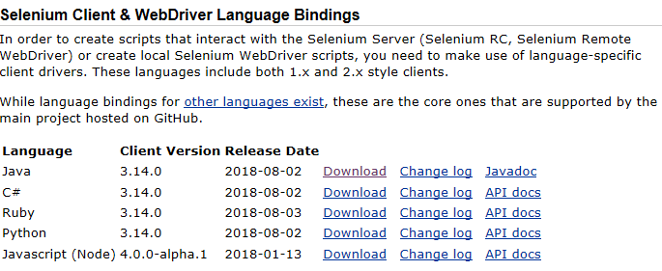
Installing Selenium Webdrivers on Netbeans
Visit https://www.seleniumhq.org/download/
Download the version for Java
Save to your folder
Extract all files

Slide 6
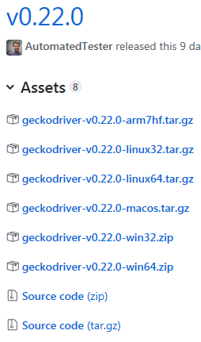
Installing Mozilla Gecko
If necessary, revisit https://www.seleniumhq.org/download/
Scroll down to third party
Click on latest for Mozilla Gecko Driver
On the GitHub page, select the version for your system
Save to your folder
Extract all files

Slide 7
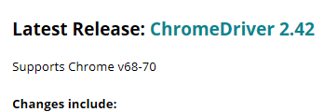
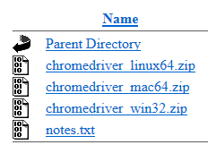
Installing Chrome Driver
If necessary, revisit https://www.seleniumhq.org/download/
Scroll down to third party
Click on latest for Google Chrome Driver
On the sites.google.com page, click ChromeDriver 2.42
Select the .zip for your system
Save into your folder
Extract all files

Slide 8
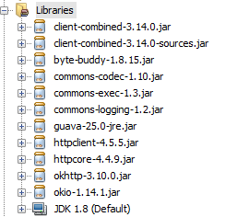
Setting up Selenium in NetBeans
After downloading the required packages open up NetBeans
Open up a project or create a new one
Right click on Libraries, Select Add jar/Folder
Browse to your Folder
Add both of the jar files from your folder
Also add ALL of the jar files in your folder\libs
These files will be under your libraries folder

Slide 9
Writing the Code
After the JAR files are added we must add the drivers to code
We then need to set the WebDriver to the proper browser type

Slide 10
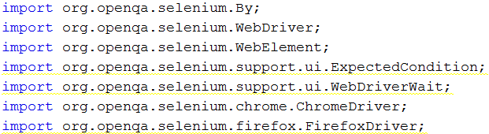
Create a simple testing script
Start with these imports

Slide 11
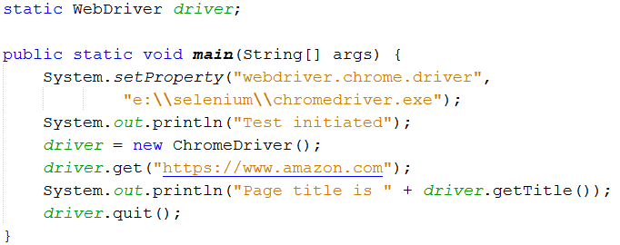
Create a simple testing script
Create this function to connect to https://www.amazon.com
Use your folder to chromedriver.exe

Slide 12
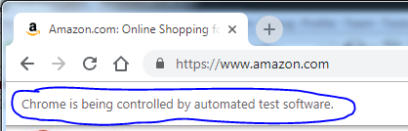
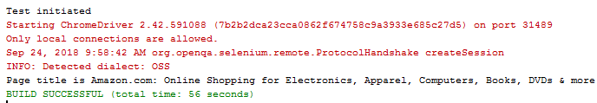
Run the program
At PTC you will get errors about ‘Failed to load extension forms’ and ‘Only local connections are allowed’ – you can ignore both
Amazon will load
The page title will print

Slide 13
Simulate a search
We are going to tell Amazon to search for milk
We will then check the browser title for changes
Create the gotMilk() function on the next page
Call in main above the driver.quit();
Run the program

Slide 14
